Slide 1
NT219- Cryptography
Week 8: Modern Asymmetric Ciphers
PhD. Ngoc-Tu Nguyen
tunn@uit.edu.vn

Slide 2
Outline
Why asymmetric cryptography?
Factoring Based Cryptography (P1)
Logarithm Based Cryptography (P2)
ElGamal cipher;
Diffie-Hellman key exchange;
Elliptic Curve Cryptography (P3)
Some advanced cryptography system (quantum resistance)
Notes:
Cipher=a secret system of writing;

Slide 3
Why Public-Key Cryptosystems?
To overcome two of the most difficult problems associated with symmetric encryption:
Key distribution (key for sysmetric encryption)
How to have secure communications in general without having to trust a K D C with your key
Digital signatures
How to verify that a message comes intact from the claimed sender
Whitfield Diffie and Martin Hellman: proposed a method that addressed both problems (1976)

Slide 4
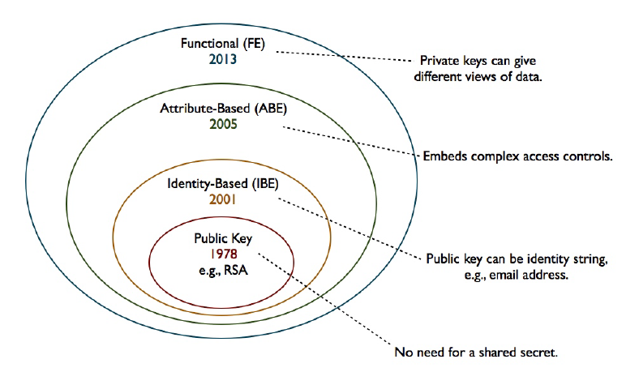





Moden Asymmetric ciphers
Symmetric cipher vs Asymmetric cipher
Hommophic, Searchable encryption,..
$ID_{A}(atributes)$
$ID_{B}(atributes)$
$$(PK_{A}, \{SK_{A},SK_{B},..\})$$
ID
$$(PK_{A}, SK_{A})$$
$$(PK_{A}, SK_{A})$$

Slide 5


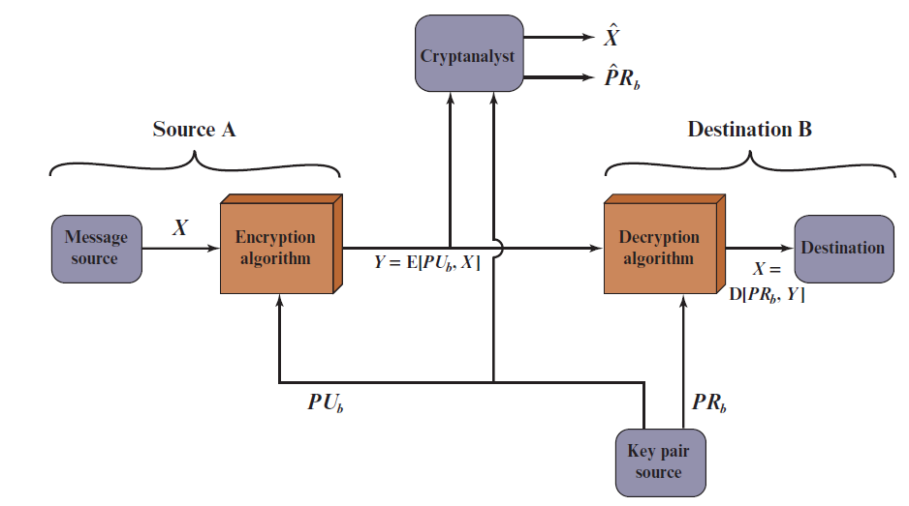
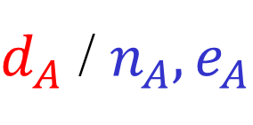


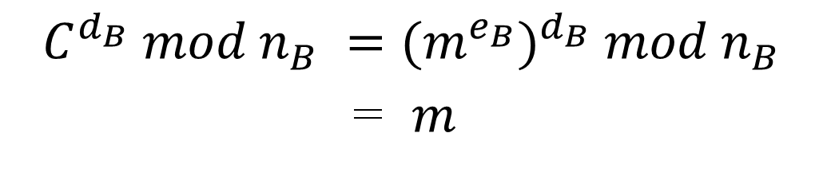

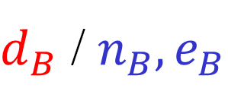
RSA: Confidentiality
A
B
$d_{A}$ / $n_{A}, e_{A}$
$d_{B}$ / $n_{B}, e_{B}$
$$e_{A}.d_{A}=1 mod φ(n_{A})$$
$$e_{B}.d_{B}=1 mod φ(n_{B})$$
$$C =m^{e_{B}} mod n_{B}$$
$$C^{d_{B}} mod n_{B} ={(m^{e_{B}})}^{d_{B}} mod n_{B}$$
= $m$
Protect secret key?
Distribute public keys?
Notes:
Let us take a closer look at the essential elements of a public-key encryption
scheme, using Figure 9.2 (compare with Figure 3.2).
The scheme illustrated in Figure 9.2 provides confidentiality.

Slide 6
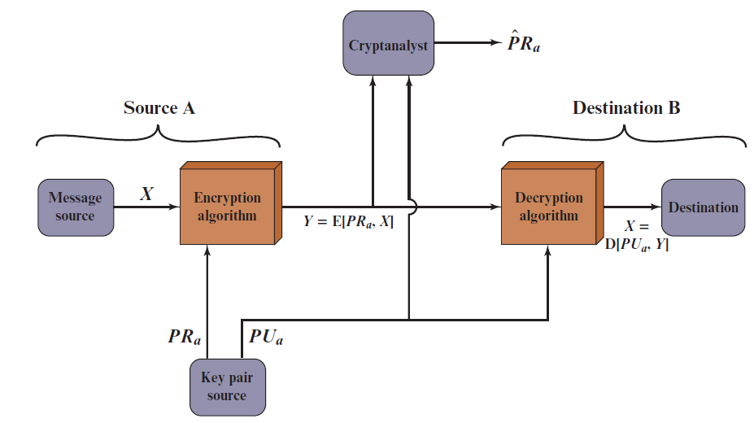
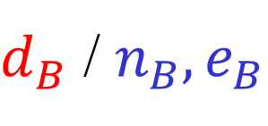

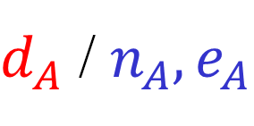

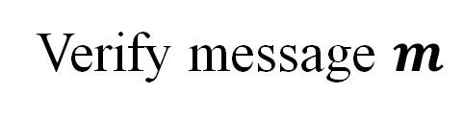
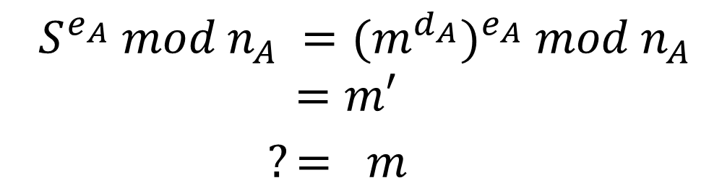
RSA: Authentication
A
B
$d_{A}$ / $n_{A}, e_{A}$
$d_{B}$ / $n_{B}, e_{B}$
$$S =m^{d_{A}} mod n_{A}$$
$$(m,S )$$
Verify message $m$
$$S^{e_{A}} mod n_{A} ={(m^{d_{A}})}^{e_{A}} mod n_{A}$$
$$=m′$$
$?= m$
Protect secret key?
Distribute public keys?
Sent by A
Original (integrity)
Notes:
Let us take a closer look at the essential elements of a public-key encryption
scheme, using Figure 9.2 (compare with Figure 3.2).
The scheme illustrated in Figure 9.2 provides confidentiality.

Slide 7
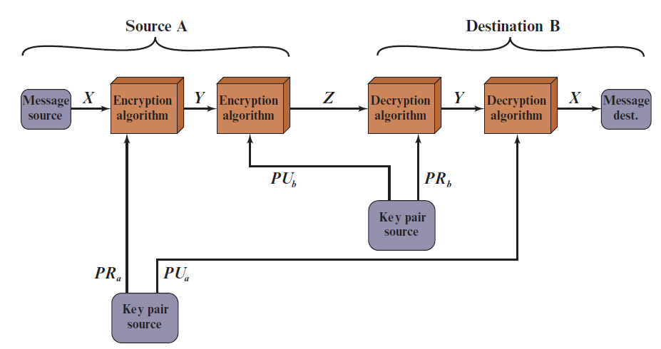


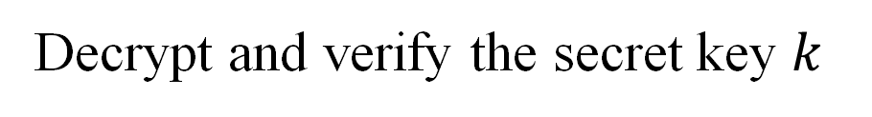
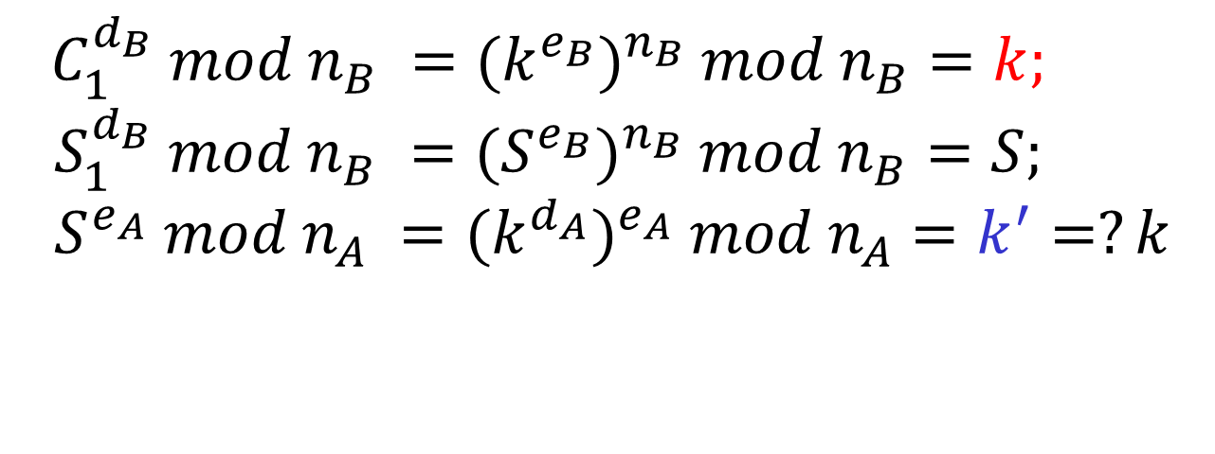
RSA: Authentication and Secrecy
A
B
$d_{A}$ / $n_{A}, e_{A}$
$d_{B}$ / $n_{B}, e_{B}$
$$S =k^{d_{A}} mod n_{A}$$
$$(C_{1}=k^{e_{B}},{S_{1}=S}^{e_{B}} )$$
Decrypt and verify the secret key $k$
$$C_{1}^{d_{B}} mod n_{B} ={(k^{e_{B}})}^{n_{B}} mod n_{B}=k;$$
$$S_{1}^{d_{B}} mod n_{B} ={(S^{e_{B}})}^{n_{B}} mod n_{B}=S;$$
$$S^{e_{A}} mod n_{A} ={(k^{d_{A}})}^{e_{A}} mod n_{A}=k^{′}=?k$$
Limitation?
Notes:
Let us take a closer look at the essential elements of a public-key encryption
scheme, using Figure 9.2 (compare with Figure 3.2).
The scheme illustrated in Figure 9.2 provides confidentiality.

Slide 8
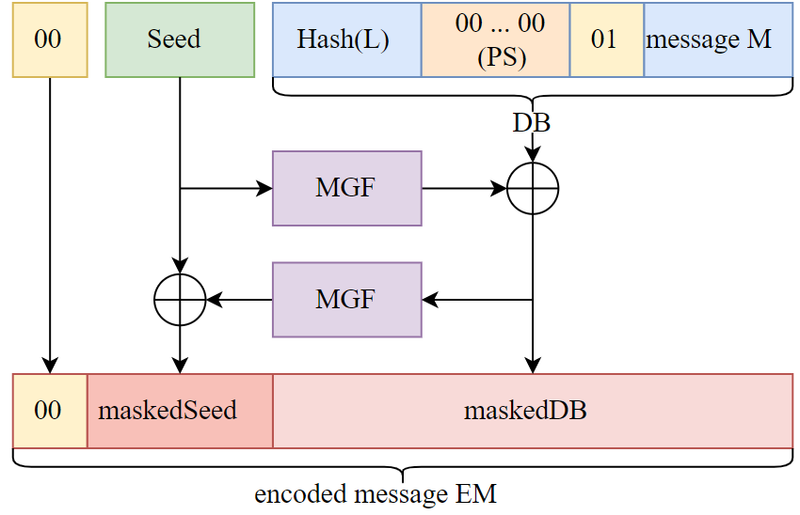


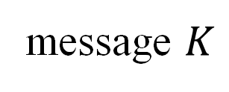
Encryption Using Optimal Asymmetric Encryption Padding (O A E P)
MGF: a hash function
$$K$$
message $K$
$$DB=H(L)||0000.. ||01||K$$
Y = MGF(Seed) ⊕ DB
X= MGF(Y) ⊕ Seed
?
X
Y

Slide 9
Outline
Why asymmetric cryptography?
Factoring Based Cryptography (P1,2)
Logarithm Based Cryptography (P3)
ElGamal cipher;
Diffie-Hellman key exchange;
Elliptic Curve Cryptography (P4)
Some advanced cryptography system (quantum resistance)
Notes:
Cipher=a secret system of writing;

Slide 10

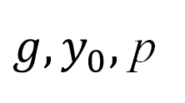


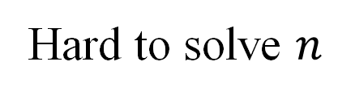
Discrete Logarithm problem
$$Finitemultiplicative group \left(G, .\right)=<g> =\{g^{n}:n∈ ℤ\}$$
Example: $G=ℤ_{p}\backslash \{0\}= \left\{1,2,…,p−1\right\}=<g>$
Easy to compute
$$y_{0}=g^{n} mod p$$
$$g, n$$
Hard to solve $n$
${g, y}_{0},$ p
$$g^{n}=y_{0} mod p$$
Hard to solve equation $g^{x}=a mod p in finite field!$

Slide 11
Outline
Why asymmetric cryptography?
Factoring Based Cryptography (P1)
RSA signature;
Logarithm Based Cryptography (P2)
ElGamal cipher
Diffie-Hellman key exchange;
Elliptic Curve Cryptography (P3)
Some advanced cryptography system (quantum resistance)
Notes:
Cipher=a secret system of writing;

Slide 12
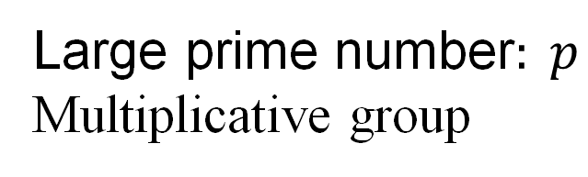
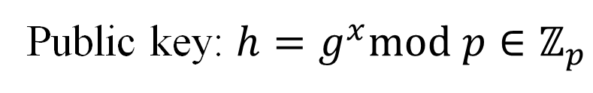
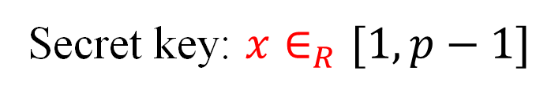
ElGamal cipher
ElGamal parameters
Large prime number$: p$
Multiplicative group
$$G=\left\langle g\right\rangle =ℤ_{p}\backslash \{0\}=\{1,2,…, p−1\}$$
Key generation (
Secret key: $x∈_{R}[1,p−1]$
Public key: $h=g^{x}mod p∈ℤ_{p}$
Notes:
The DSA is based on the difficulty of computing discrete logarithms (see Chapter 2)
and is based on schemes originally presented by Elgamal [ELGA85] and Schnorr
[SCHN91].
Figure 13.3 summarizes the algorithm.
There are three parameters that are public and can be common to a group of users. An N-bit prime number q is chosen. Next, a prime number p is selected with a length between 512 and 1024 bits such that q divides (p - 1). Finally, g is chosen to be of the form h^{(p-1)/q} mod p, where h is an integer between 1 and (p - 1) with the restriction that g must be greater than 1. Thus, the global public-key components of DSA are the same as in the Schnorr sig- nature scheme.
With these parameters in hand, each user selects a private key and generates a public key. The private key x must be a number from 1 to (q - 1) and should be chosen randomly or pseudorandomly. The public key is calculated from the private key as y = g^{x} mod p. The calculation of y given x is relatively straight- forward. However, given the public key y, it is believed to be computationally infeasible to determine x, which is the discrete logarithm of y to the base g, mod p (see Chapter 2).
The signature of a message M consists of the pair of numbers r and s, which are functions of the public key components (p, q, g), the user’s private key (x), the hash code of the message H(M), and an additional integer k that should be generated randomly or pseudorandomly and be unique for each signing.
Let M, r′, and s′ be the received versions of M, r, and s, respectively. Verification is performed using the formulas shown in Figure 13.3. The receiver generates a quantity v that is a function of the public key components, the sender’s public key, the hash code of the incoming message, and the received versions of r and s. If this quantity matches the r component of the signature, then the signature is validated.

Slide 13
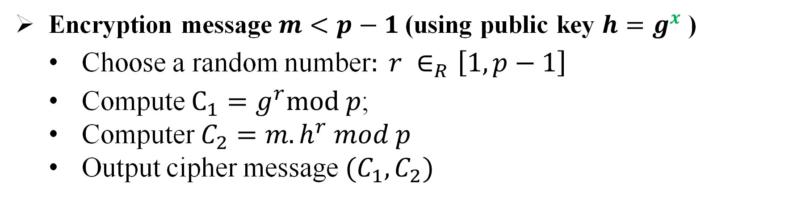
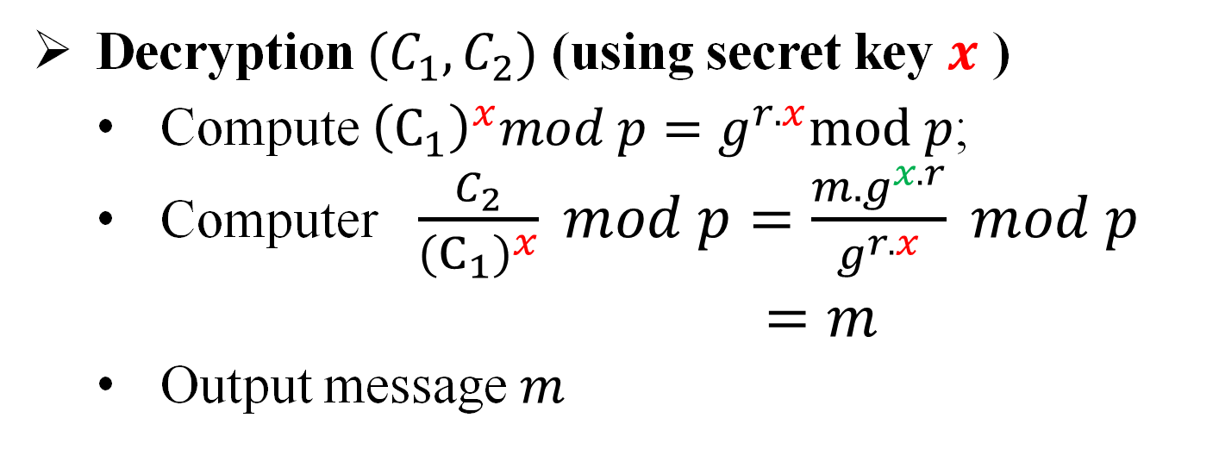
ElGamal cipher
Encryption message $m<p−1$(using public key $h=g^{x}$ )
Choose a random number$: r ∈_{R}\left[1,p−1\right]$
Compute $C_{1}=g^{r}mod p$;
Computer $C_{2}=m.h^{r} mod p$
Output cipher message $(C_{1},C_{2})$
Decryption $(C_{1},C_{2})$ (using secret key $x$ )
Compute ${\left(C_{1}\right)}^{x}mod p=g^{r.x}mod p$;
Computer $\frac{C_{2}}{{\left(C_{1}\right)}^{x}} mod p=\frac{m.g^{x.r}}{g^{r.x}} mod p$
$=m$
Output message $m$

Slide 14

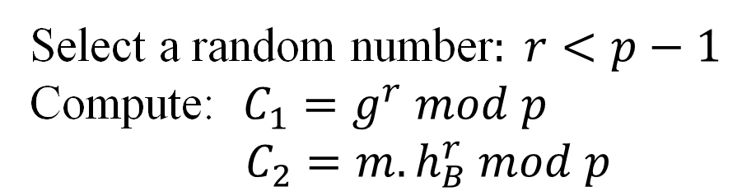
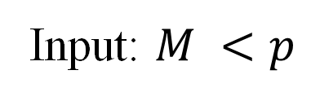

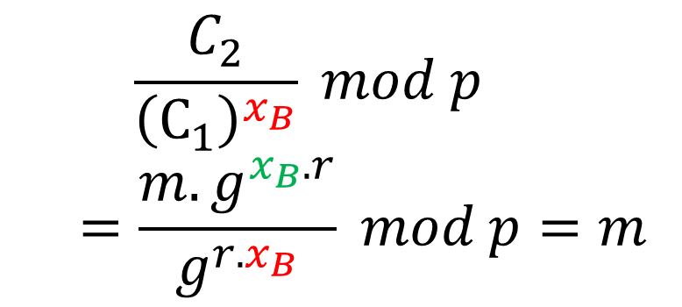
ElGamal cipher
A
public key
B
public key
?
public key
private key
$$PU_{B}=h_{B},p$$
$$(PR_{B}=x_{B}, PU_{B}={h_{B}=g}^{x_{B}},p)$$
Input: $M <p$
$${(C}_{1},C_{2})$$
Compute:
Select a random number$: r<p−1$
Compute: $C_{1}=g^{r} mod p$
$C_{2}=m.h_{B}^{r} mod p$
$$\frac{C_{2}}{{\left(C_{1}\right)}^{x_{B}}} mod p$$
$$=\frac{m.g^{x_{B}.r}}{g^{r.x_{B}}} mod p=m$$

Slide 15
Outline
Why asymmetric cryptography?
Factoring Based Cryptography (P1)
RSA signature;
Logarithm Based Cryptography (P2)
ElGamal cipher
Diffie-Hellman key exchange;
Elliptic Curve Cryptography (P3)
Some advanced cryptography system (quantum resistance)
Notes:
Cipher=a secret system of writing;

Slide 16
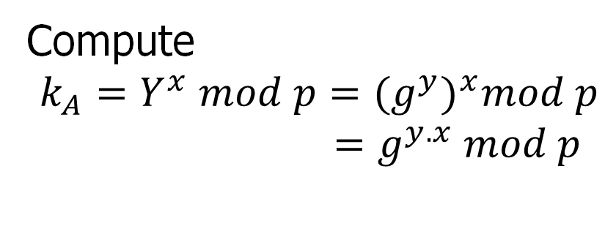

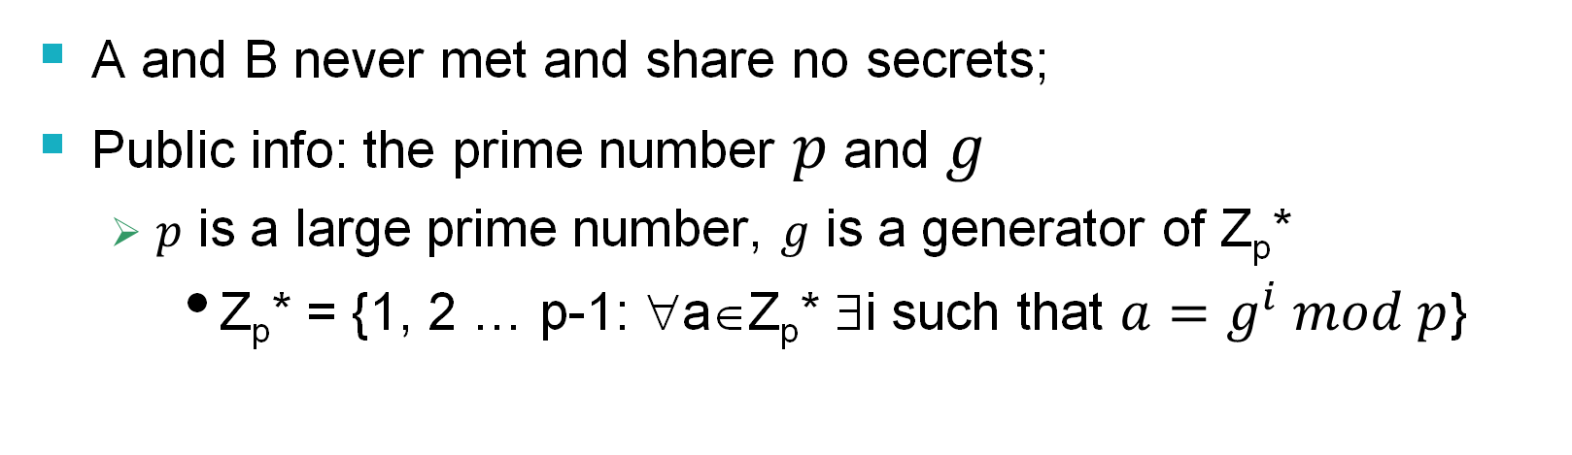

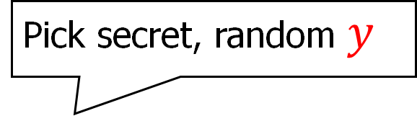
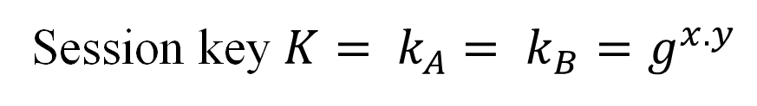
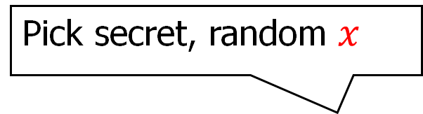
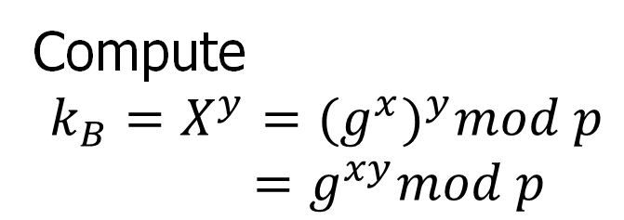
Diffie-Hellman key exchange
A and B never met and share no secrets;
Public info: the prime number $p$ and $g$
$p$ is a large prime number, $g$ is a generator of Z_{p}*
Z_{p}* = {1, 2 … p-1: ∀a∈Z_{p}* ∃i such that $a=g^{i} mod p$}
Pick secret, random $x$
Pick secret, random $y$
$$X=g^{x} mod p$$
A
$$Y=g^{y} mod p$$
B
Compute
$k_{A}=Y^{x} mod p={{(g}^{y})}^{x}mod p$
$=g^{y.x} mod p$
Compute
$k_{B}=X^{y}={(g^{x})}^{y}mod p$
$=g^{xy}mod p$
Session key $K= k_{A}$ $= k_{B}=g^{x.y}$
Symmetric key

Slide 17
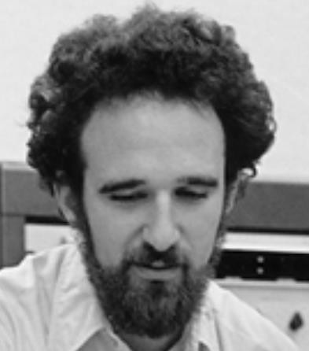
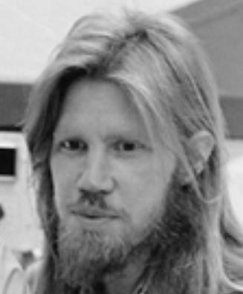


Diffie-Hellman exchange Protocol (DHE)
p = 1606938044258990275541962092341162602522202993782792835301301
𝑔 = 123456789
𝑔^{𝑎} mod p = 78467374529422653579754596319852702575499692980085777948593
𝑔^{𝑏} mod p =
560048104293218128667441021342483133802626271394299410128798
𝑎 =
685408003627063
761059275919665
781694368639459
527871881531452
𝑏 =
362059131912941
987637880257325
269696682836735
524942246807440
𝑔^{𝑎𝑏} mod p = 437452857085801785219961443000845969831329749878767465041215
${{(g}^{b})}^{a}$ $mod p$
$${{(g}^{a})}^{b}mod p$$

Slide 18
Why Is Diffie-Hellman Secure?
Discrete Logarithm (DL) problem:
given g^{x} mod p, it’s hard to extract x
There is no known efficient algorithm for doing this
This is not enough for Diffie-Hellman to be secure!
Computational Diffie-Hellman (CDH) problem:
given g^{x} and g^{y}, it’s hard to compute g^{xy} mod p
… unless you know x or y, in which case it’s easy
Decisional Diffie-Hellman (DDH) problem:
given g^{x} and g^{y}, it’s hard to tell the difference between g^{xy} mod p and g^{r} mod p where r is random

Slide 19
Properties of Diffie-Hellman
Assuming DDH problem is hard, Diffie-Hellman protocol is a secure key establishment protocol against passive attackers
Eavesdropper can’t tell the difference between the established key and a random value
Can use the new key for symmetric cryptography
Basic Diffie-Hellman protocol does not provide authentication
IPsec combines Diffie-Hellman with signatures, anti-DoS cookies, etc.

Slide 20










Man-in-the middle attacks the DHE
$$g^{a} mod p$$
$$(a,g^{a})$$
$$(b,g^{b})$$
$$g^{b} mod p$$
$$sk={{(g}^{b})}^{a}={{(g}^{a})}^{b}=g^{ab}mod p$$
B()
A(Putin)
man-in-the-middle attack!
$$g^{m} mod p$$
$$g^{a} mod p$$
$$g^{m} mod p$$
$$g^{b} mod p$$
$$sk_{1}=g^{am}mod p$$
$$sk_{2}=g^{bm}mod p$$

Slide 21
Advantages of Public-Key Crypto
Confidentiality without shared secrets
Very useful in open environments
Can use this for key establishment, avoiding the “chicken-or-egg” problem
With symmetric crypto, two parties must share a secret before they can exchange secret messages
Authentication without shared secrets
Encryption keys are public, but must be sure that Alice’s public key is really her public key
This is a hard problem… Often solved using public-key certificates

Slide 22
Disadvantages of Public-Key Crypto
Calculations are 2-3 orders of magnitude slower
Modular exponentiation is an expensive computation
Typical usage: use public-key cryptography to establish a shared secret, then switch to symmetric crypto
SSL, IPsec, most other systems based on public crypto
Keys are longer
3072 bits (RSA) rather than 128 bits (AES)
Relies on unproven number-theoretic assumptions
Factoring, RSA problem, discrete logarithm problem, decisional Diffie-Hellman problem…

